Slide 1
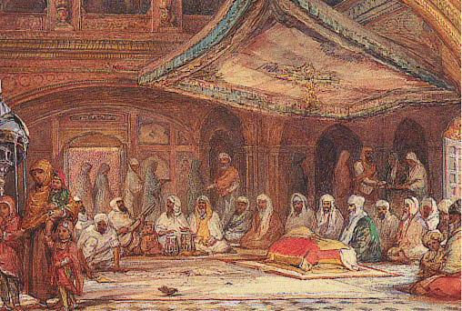
GURU GRANTH SAHIB — A UNIVERSAL SCRIPTURE FOR WORLD PEACE

Slide 2
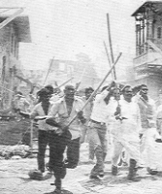
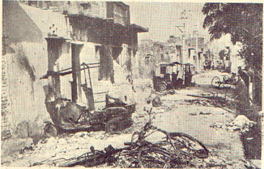
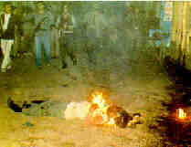
The relevance and significance of gurbani for world peace can be understood if we discuss the answer to the serious question quite often asked
The Question
Why not abolish all religions?
From the very time of their founding, they have divided people into mutually hating groups.
Moreover, this hatred is spreading and being intensified every day.
We have witnessed shedding of innocent blood all over the globe and unfortunately, it is going on even at this time.
Is, then, there any logic for retaining religion?

Slide 3
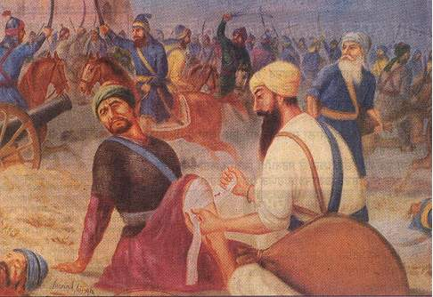
The Answer
Many scholars, who have studied Guru Granth Sahib, agree that gurbani provides the answer to this question.
The message of Guru Granth Sahib, gurmat, popularly called Sikhism, preaches, “Do not divide people into Hindus and Muslims; all are children of God, hence equal.
No one is superior or inferior and no one is alien.”
This philosophy is elaborated in hundreds of hymns which all of you know; only four of these are quoted below

Slide 4
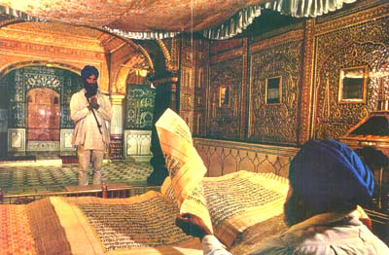
1. I am neither a Hindu nor a Muslim, my body & soul have been gifted to me by Allah and Ram
2 We all are children of th same one Father
3. God Himself has created all the human human beings, the same light being the source of all life, how can people (by birth) be divided into good and bad persons.
4.When I got into the company of the holy people, the feeling of otherness got washed away from my mind.
5.Now, I find that all persons are the members of my family, neither anyone is my foe nor anyone is alien to me

Slide 5
jo s[e o{j S{zjdh j?. jo p'b sopK S/Vdk j?. jo Fpd Mzi'V ;[ZNdk j?. jo ;[o nzdobh sko fjbk d/Adh j?. o{j dk e'Jh w;bk j't/, fJE/ jZb dZf;nk frnk j?.

Slide 6
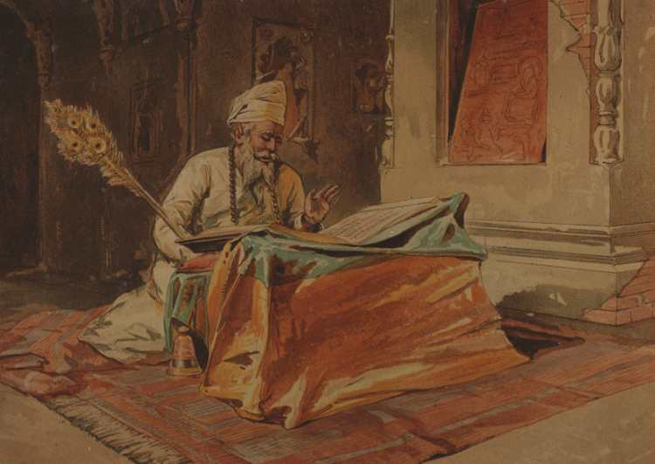
Ram and Allah are two of the innumerable names of the same Lord.
In gurbani, both these names refer to the Creator, the Common Father of the whole humanity, not the God either of Hindus or of Muslims alone.
Gurbani accepts all the innumerable names given to Him by His devotees of different cultures and faiths.
Many such names have been mentioned in Guru Granth Sahib.

Slide 7
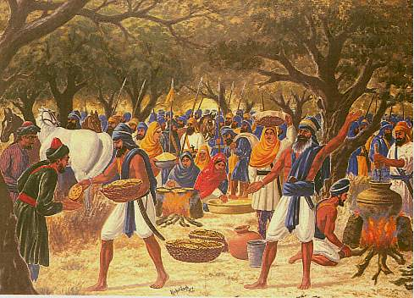
This philosophy did not remain a theory for our intellectual exercise.
The Gurus demonstrated its practicability through the institutions of sangat and pangat. Hindus and Muslims, high caste & low caste, men and women, all sat together as equals (sangat) to sing the praises of the Lord, their common Father, addressing Him by many different names with equal love.
To share their feelings of brotherhood, they cooked food together and partook of it together (pangat) without any kind of discrimination.

Slide 8
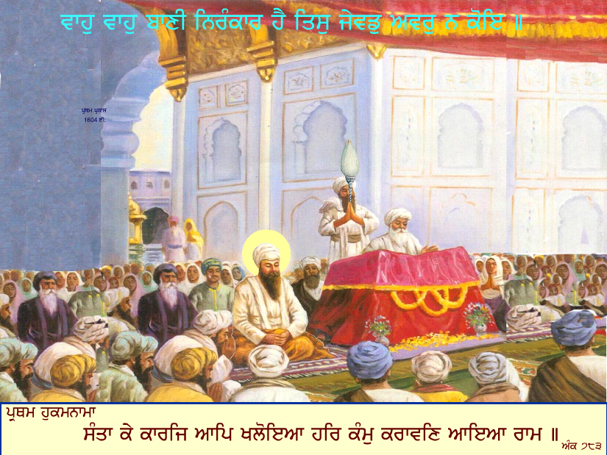

Thread of Peace
Where and why have we missed this lesson of gurbani?
We need to reintroduce it to spread the message of the unity of humanity.
It should be an issue to be discussed by scholars and social leaders to plan the celebration of the forthcoming fourth centenary of Guru Granth Sahib.
Accordingly, they should draw an action plan to pick up the thread of peace and move forward to create peace all over the globe by developing mutual love among all sections of society.

Slide 9
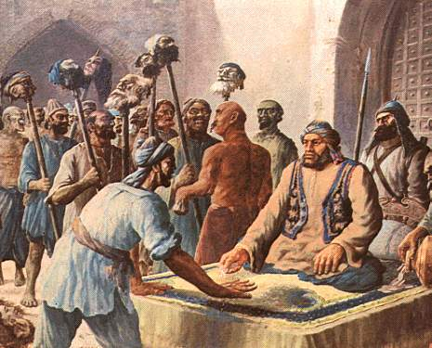
so that we learn to respect others as equal members of the larger brotherhood, humanity.
Unfortunately, we see the believers of gurbani strongly divided among themselves.
Gianis, scholars, politicians, heads of different deras, etc., differ a lot on the details of the message of gurbani and the code of conduct prescribed for a Sikh.
This does need sacrifice, of course, perhaps not of our heads as during the 18th century, but surely of our ego

Slide 10
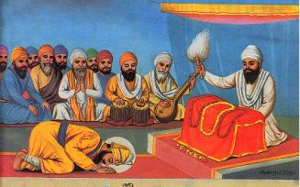
The institution of Guru Panth which was to provide a common platform for keeping the Sikhs united and moving on the gaadi rah (highway of gurmat) has slowly been diluted unrecognizably, and hence made ineffective.
Maybe, this appeal will awaken us to the message of gurbani and remind us of our responsibilities as believers of gurmat.
Let us make a beginning, God will surely bless us.
The institution of Guru Panth

Slide 11
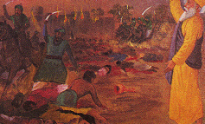
Another revolutionary aspect of the revelations of gurbani is that nobody can claim a monopoly over God.
Gurbani explains that He is our Common Father and He loves us all equally.
Hatred arises when the followers of a faith preach themselves to be the only true believers and regard members of other faiths as non-believers.
With a wrong belief of ‘saving’ members of other faiths, they actually bribe, pressurize, torture and even threaten to kill them (sometimes they do kill them to persuade others), all to generate more converts to their faith.

Slide 12
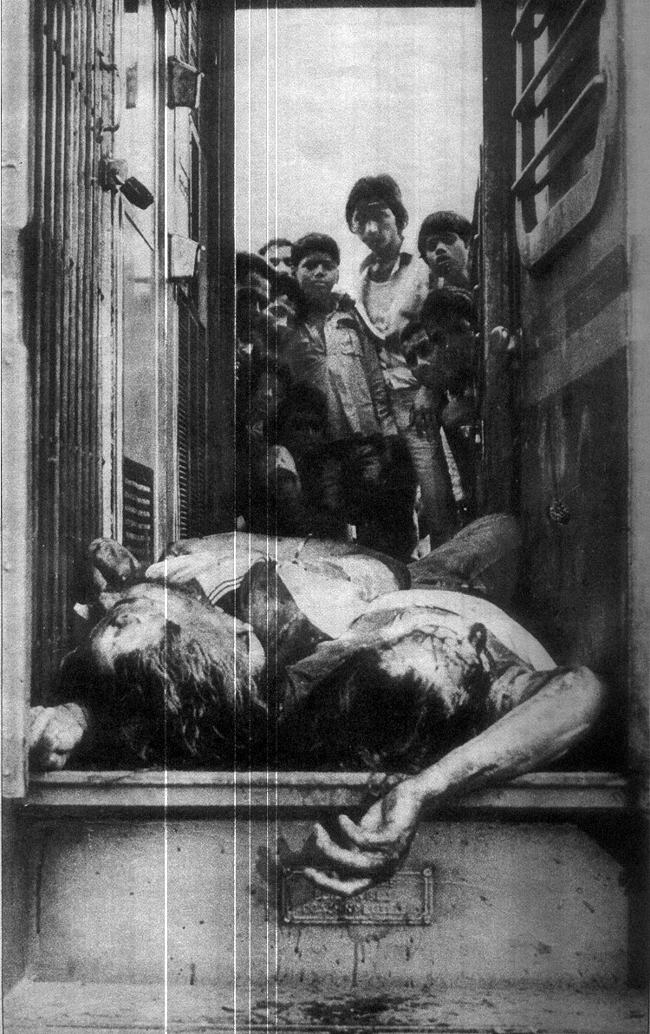
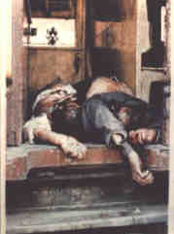
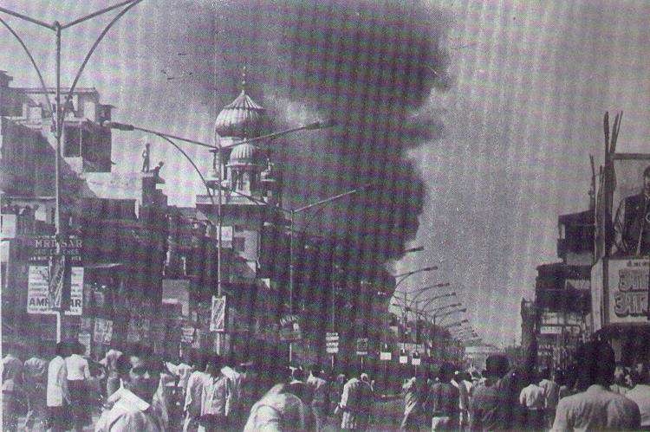
Many people in power are, as in the past, still committing this serious sin, which also is a crime, believing it to be a pious act.
While they think they are doing a favour to the ‘non-believers’ (people of other faiths) to save them from the assumed Hell, they create a real hell for them on this very earth.

Slide 13
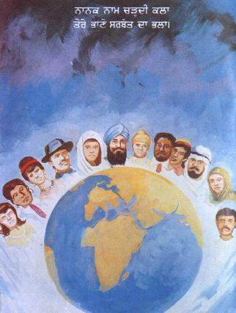
Gurbani decries such forced conversions by declaring, “God is nobody’s father’s property to make a sole claim on Him. He belongs to all those who love Him
In addition, gurbani tells that He graces all those who remember Him
Moreover, the Sikh prayer always ends with a request for the welfare of whole humanity,, not just of Sikhs or of Indians alone.
(History tells us that the Gurus and the Sikhs put this prayer into practice at the cost of their own heads.)
Sikh prayer always ends with a request for the welfare of whole humanity

Slide 14
Struggle for Human Rights
To ensure peace, Guru Nanak preached protection of human rights, particularly of the lowly and the weak. Gurbani, therefore, warns the tyranical rulers and administrators against their inhuman actions.
It says that true kings are those who respect truth and deliver justice to common persons; only such persons deserve to be rulers.
i) Delivering justice is the responsibility (duty) of a king
ii) Only a competent person who understands Truth should occupy the throne (become a ruler) so that he can deliver justice.

Slide 15
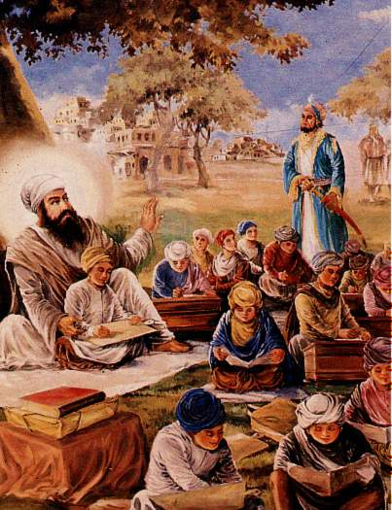
Guru Nanak exposed tyrannical rulers, corrupt religious teachers as well as corrupt judges through very harsh and strong words.
They were compared with blood-sucking beasts.
i) The kings behave as blood-sucking beasts and their officers act as biting dogs.
ii) The judge the authority for justice) is corrupt (He takes bribe). The Brahman & Yogis (religious authority for spiritual guidance) suck the blood of the innocent followers (by charging heavily for performing meaningless rituals).
All these are responsible for the problems of the people

Slide 16
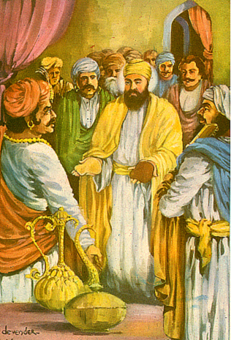
On the economic front
On the economic front, he condemned the dishonest and corrupt people who take away the rights of others, describing them as the greatest sinners.
Taking away the rights of others is like eating beef by a Hindu and eating pork by a Muslim (a most sinful act, one loses one’s faith if one commits this act
Further, to help the needy, he advised that one tenth of one’s earnings should be shared for social welfare.
He said that serving the poor is serving God.
Taking away the rights of others is a most sinful act,

Slide 17
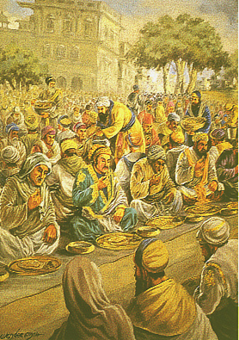
sangat and pangat
To ensure social equality, he founded the institutions of sangat and pangat as stated earlier.
Splitting of society into high caste and low caste by birth is strongly decried by gurbani.
i) Do not claim any superiority over others because of your caste, it is the act of an idiot, it leads to many illsii) All humans form a common fellowship. O God, You are not an alien to anyone.
The pride of caste is basically wrong and harmful.
We are all equal and no one is alien.
When Emperor Akbar, came to see the Guru, had to sit with other common people and dine together with them before the Master gave consent to see them.

Slide 18
Universal Brotherhood in Practice
The character of the Khalsa to respect people of all faiths during the 18th century is well documented.
I wish to quote a small incident of the 20th century also to show how the Sikhs treated people of other religions with love.
About two decades ago an old man, unable to walk on his own, and supported on both sides by two burly Sikhs, was led out of the Ross Gurdwara, Vancouver, Canada.
His harsh Panjabi words expressed his great frustration and anger for not finding non-Sikhs in the gurdwara. “Why have you brought me here?
This also is not the Gurdwara where we all ‘brothers’, Sikhs, Hindus, Muslims & Goras (European Canadians) jointly cooked langar and partook of it together.”

